Slide 1
Quick Ship Program & SLA Pressure Controllers
Cyber Road Show Webinar
May 24, 2017

Slide 2
Agenda
80/20 Business Process – Ren Jenkins
Quick Ship Program – Christine Batycki
Selling SLA Pressure Controllers – Shelly McWilliams

Slide 3
80/20 Business Process
Why Quick Ship?
Provide shorter lead times on common options and configurations so we increase customer satisfaction
Help you drive more sales
Enabling our Operations team to focus on producing higher volumes of fewer SKUs reduces complexity and simplifies the sales cycle.
Notes:
We’re here today to present the Quick Ship program to you.
Why Quick Ship you ask?
The goal of the Quick Ship program is to provide shorter lead times on common options and configurations so we satisfy customers and help you drive more sales.
Becoming easier to do business with will delight our customers.
Before we get into the details of Quick Ship, we’re going to give you some background on the business philosophy this is based on.

Slide 4
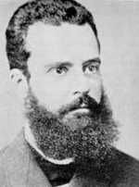
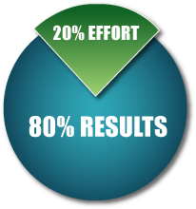
80/20 Business Process
Where did 80/20 come from?
The 80/20 principle originated from Vilfredo Pareto, an Italian economist, who in the late 1800s studied the distribution of wealth in various countries. He consistently found that 80% of the wealth was owned by 20% of the population in these countries.
The Pareto Principle
Vilfredo Pareto
Notes:
A key element of ITW’s Business Model that it seeks to implement in all of its businesses is the 80/20 Business Process.
The 80/20 Business process is based on the 80/20 principle, which you have all likely heard of…
The 80/20 principle originated from Vilfredo Pareto, an Italian economist, who in the late 1800s studied the distribution of wealth in various countries. He consistently found that 80% of the wealth was owned by 20% of the population in these countries. (The Pareto Principle or 80/20 Rule)
Since then, people have learned that the 80/20 principle applies to all aspects of personal and professional life.
Examples: clothes you wear + 20% of your activity at work yields 80% of your results
His observation is popularly known as “The Pareto Principle”

Slide 5
80/20 Business Management Excellence
Key Principles
COMPLEXITY is the root cause of poor execution and excess cost
All business is NOT good business
Treat the “80” DIFFERENTLY from the “20”
20% OF THE ACTIVITY
(CUSTOMERS/PRODUCTS/TRANSACTIONS)
DRIVES 80% OF THE RESULTS
Notes:
Use grocery store examples, it’s not exactly the same but a close, consumer example.

Slide 6
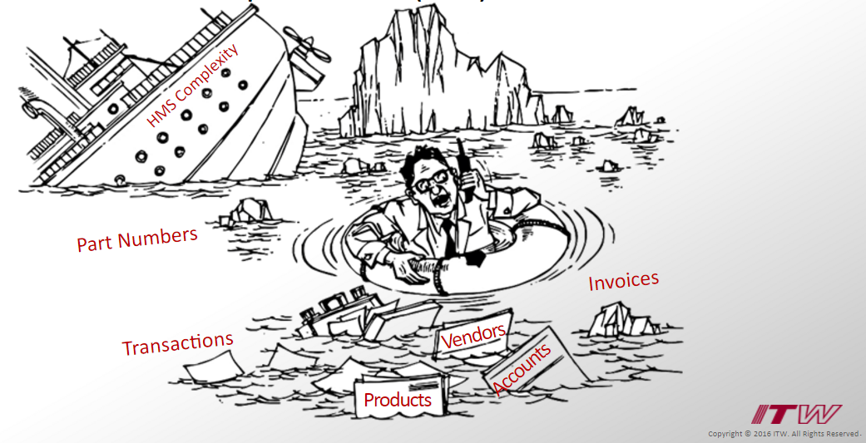
80/20 Business Process
How does this apply to Brooks?
Complexity naturally creeps in as we add product lines, customers, suppliers…
The Brooks business model: custom configurations + accept orders for difficult, complex configurations our competitors avoided.
Notes:
Well, over time, complexity naturally creeps in to a business as we add product lines, customers, suppliers and their associated transactions and maintenance.
Add to that the fact that at Brooks specifically, our business model for nearly our entire 70 year history has been custom configurations and being willing to accept complex orders that other suppliers would not.
It’s a proven fact that when you give people more choices, they will chose them – further driving the vicious cycle of complexity.
But when you offer fewer choices, decision making becomes easier for the customer and drives simplicity.

Slide 7
80/20 Business Process
The Hidden Costs of Complexity
Complexities arise when there are too many options, configurations and/or products.
A business incurs hidden costs when its processes and functions grow complex.
Complexity
Too Many Options
Lack of Customer Service
Notes:
Let’s talk about complexity in more detail and how it impacts a business
Complexities arise when there are too many options, configurations and/or products.
Too many choices cause a business’ processes and functions to grow complex, creating hidden costs for the business and a lack in customer service

Slide 8
80/20 Business Process
Results of Complexity
Too Many Options Affects:
Scheduling - Planning the manufacture of multiple configurations requires more effort than scheduling production of a few configurations
Set-up - Manufacturing multiple configurations leads to increased downtime switching from one to another
Complexity
Too Many Options
Lack of Customer Service
Notes:
More specifically, here are just some of the results of complexity

Slide 9
80/20 Business Process
Results of Complexity
Too Many Options Affects:
Materials - Procuring materials, longer lead time, managing suppliers, and stocking materials requires additional staff and other overhead costs
Marketing - An increase in configurations is difficult to communicate to customers and requires maintaining additional materials like price lists
Complexity
Too Many Options
Lack of Customer Service
Notes:
More specifically, here are just some of the results of complexity

Slide 10
80/20 Business Process
Results of Complexity
Lack of Customer Service:
Poor time management
Lack of in-depth sales calls
Increased order tracking
High effort on Receivables
Loss of customers
Complexity
Too Many Options
Lack of Customer Service
Notes:
And finally, complexity ends up causing (read list of bullets)
And now, I’m going to turn the presentation over to Christine, to review the Quick Ship program with you.

Slide 11
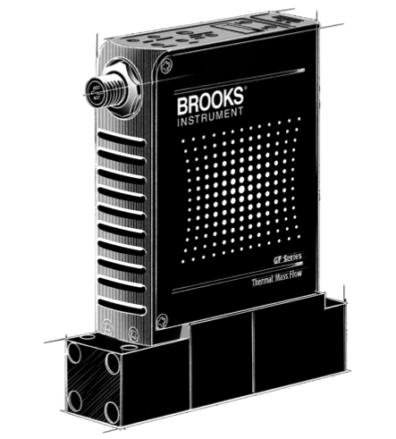
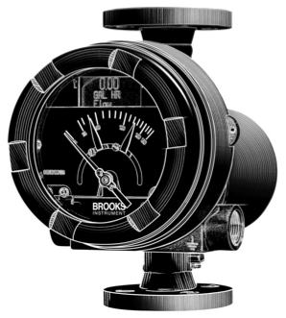
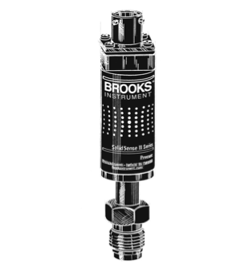
Quick Ship
Christine Batycki
Notes:
Hi everyone. Let’s start by re-stating our goal with Quick Ship, and that is, we want to make it easier for you and for our customers to understand which options have shorter lead times so that customers can make better choices about what they order, and ideally, better equip YOU to influence their purchase when products are being spec’d in. Let’s face it, we all have 1,000 things competing for our attention in any given moment – if we can make it easier for you to guide the sales process, then it’s a worthy investment of our time.

Slide 12
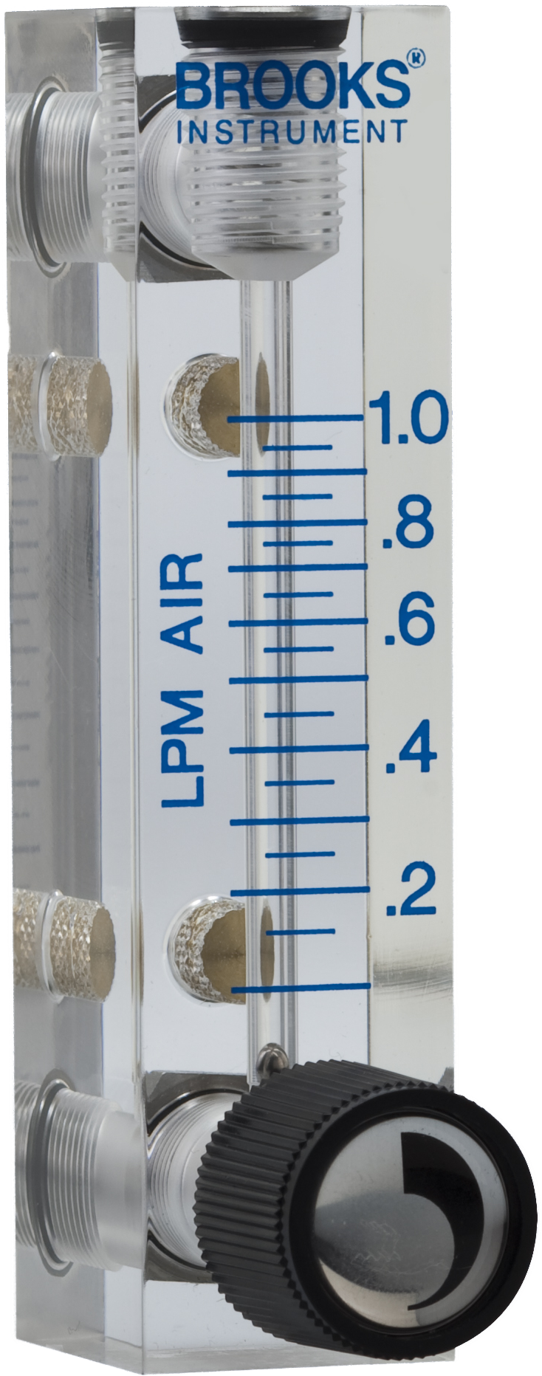
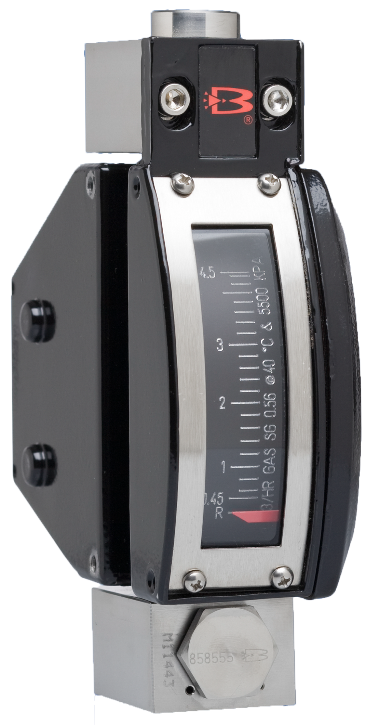
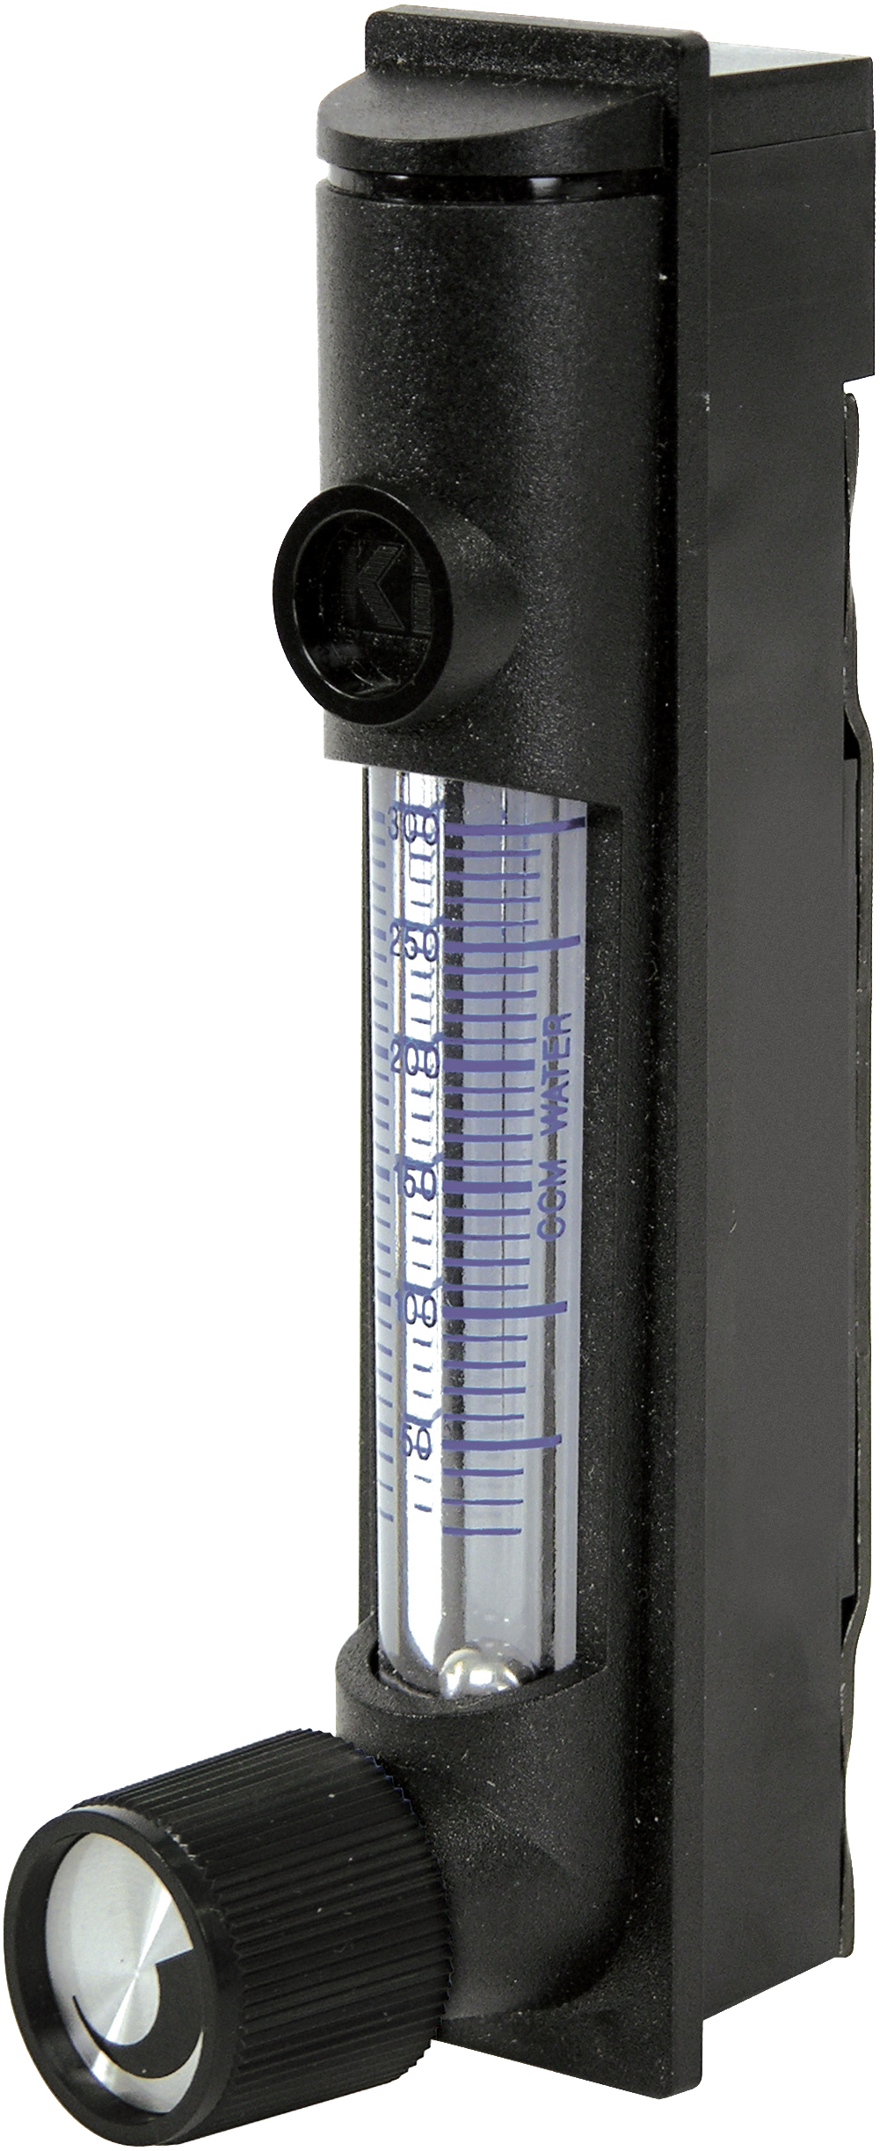
Products Available for Quick Ship
Variable Area Flow Meters
Plastic Tube | Glass Tube | Metal Tube
2500 Series | 1250/1255 Series | MT3750 Series
3000 Series | 1350/1355 Series
Notes:
At first glance, some of you may be thinking, “These are not the products I need to be QuickShip.” All we ask is that you hear out the program and help us figure out how to market this so that we start to change our behavior. You just heard all the reasons why it’s good to drive volume toward common options – let’s do it with these products so that we build the discipline and momentum to do it with more products and add to the program.”
[name the products]

Slide 13
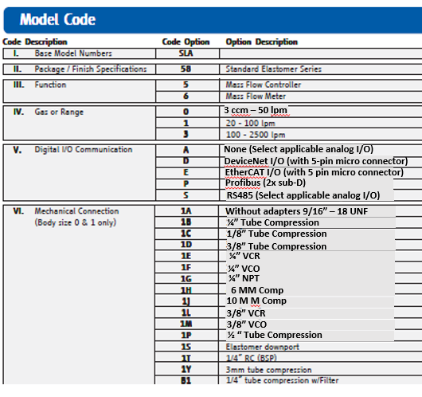
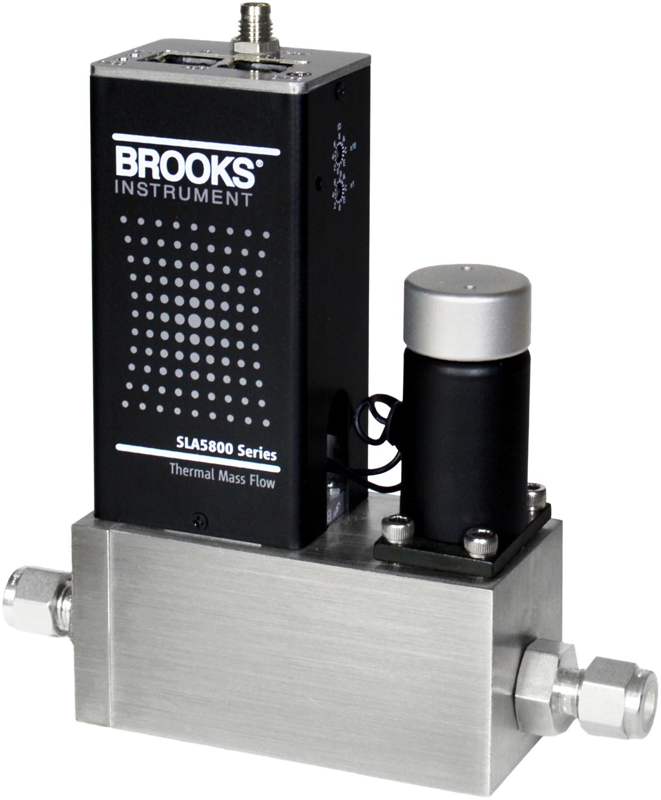
Products With “Best Selling Options” Designated
SLA5800 Series Elastomer Sealed MFCs
Notes:
Pause for a moment and point out the SLA
Do Not meet the Quick Ship designation of 5 days – rather, the options you see highlighted here are at 10 days and we are still executing on data sheet updates

Slide 14
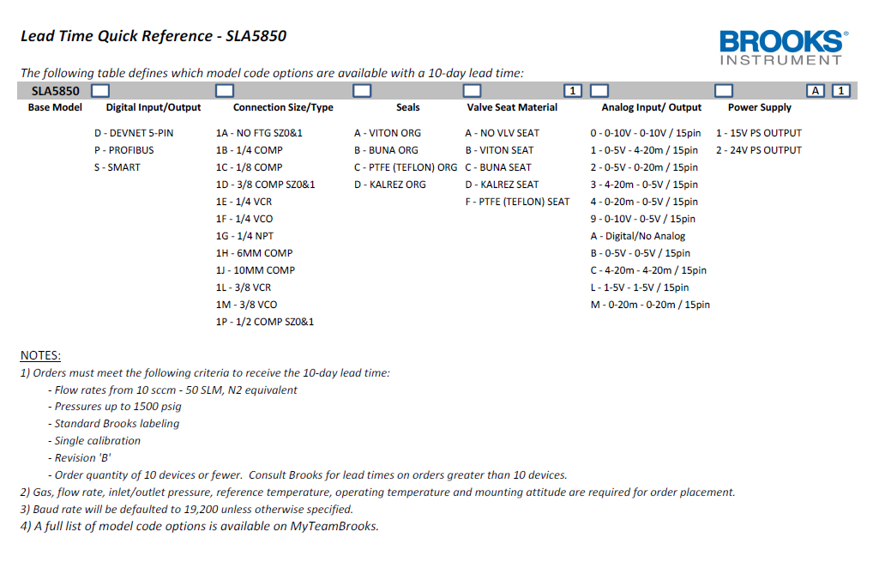
Products With “Best Selling Options” Designated
SLA5800 Series Elastomer Sealed MFCs
Notes:
June 2015

Slide 15
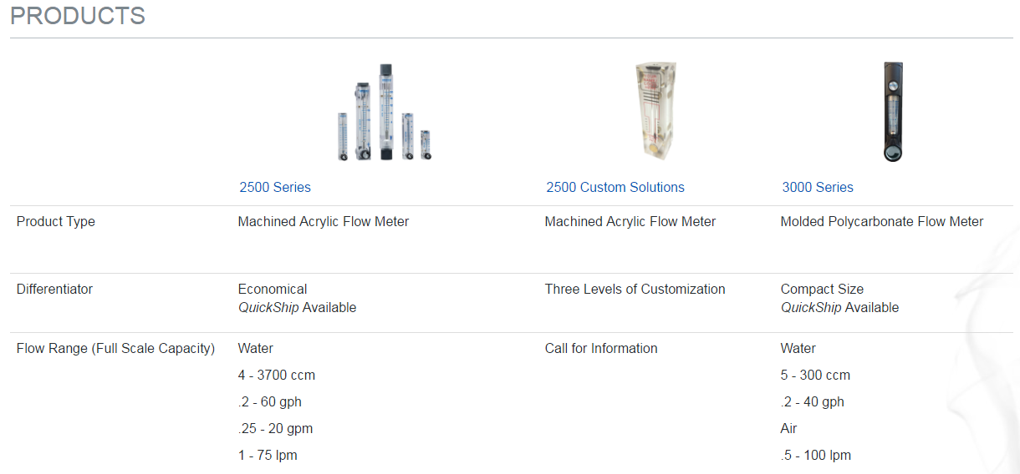
Products Available for Quick Ship
Highlighted on BrooksInstrument.com
Notes:
Customer journey – website, data sheets, order into MTB

Slide 16
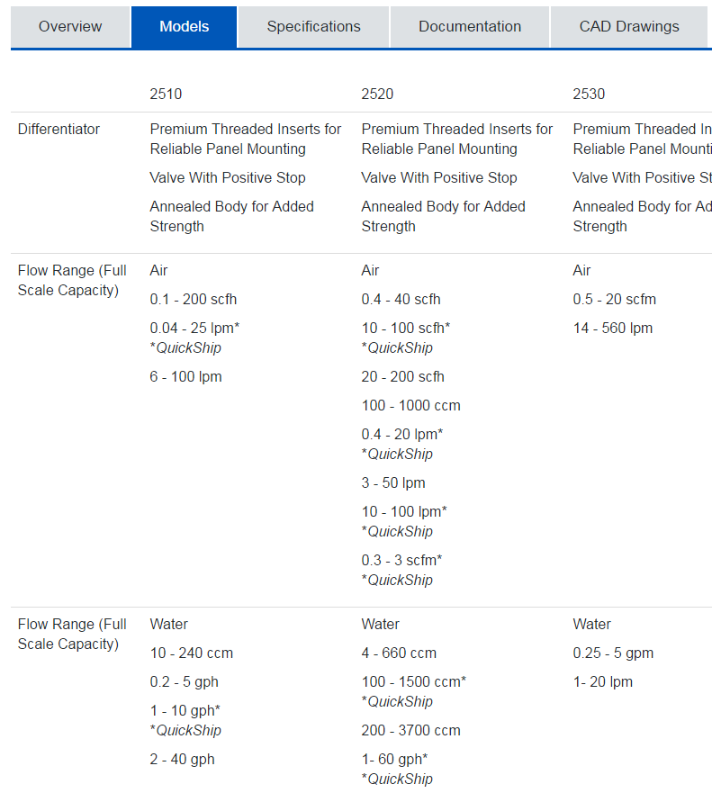
Products Available for Quick Ship
Highlighted on BrooksInstrument.com

Slide 17
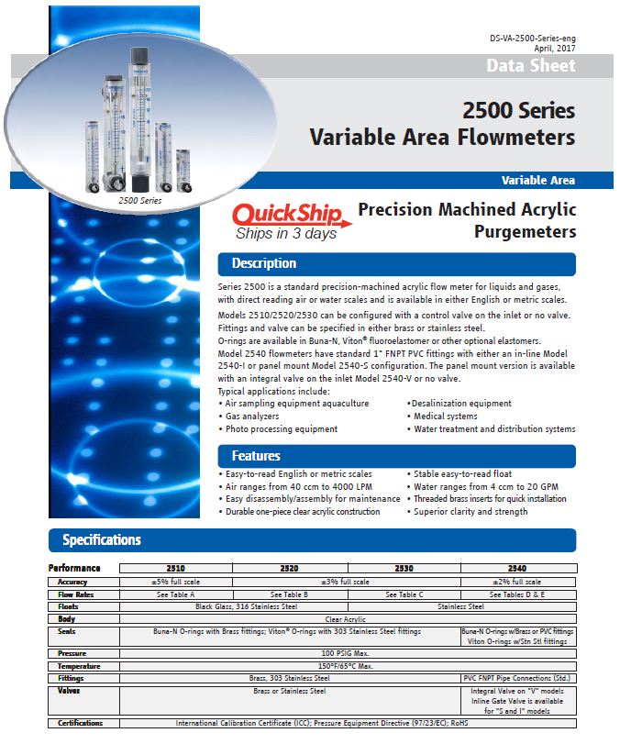
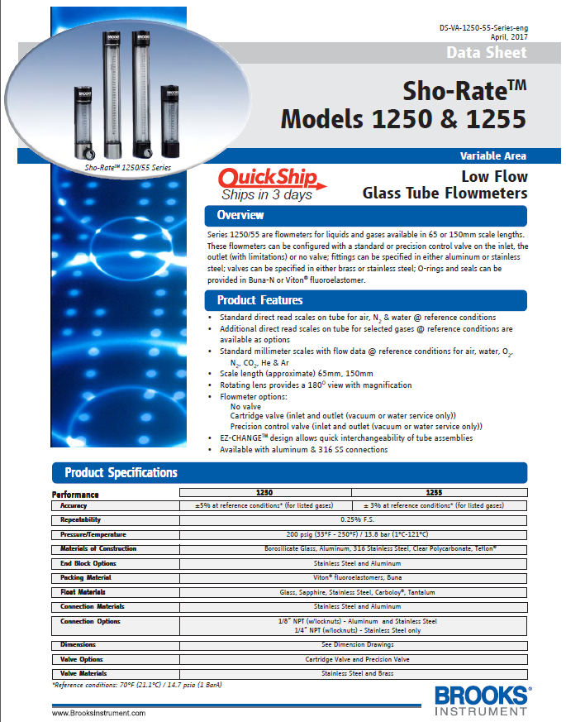
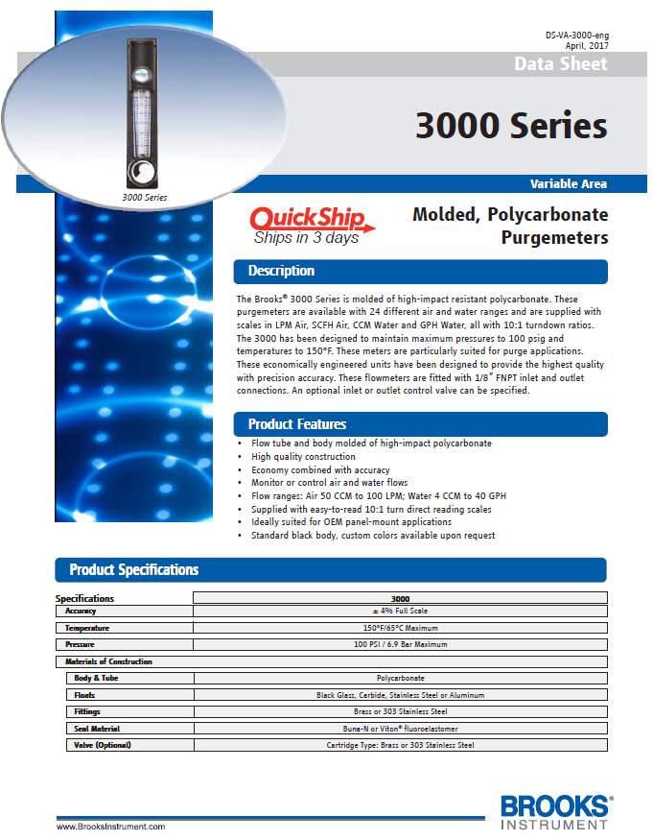
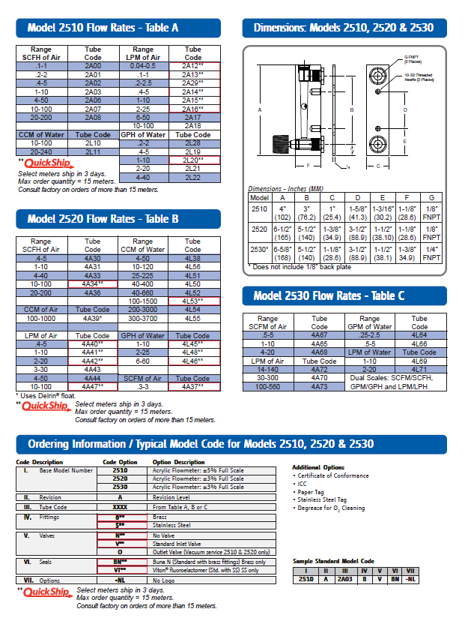
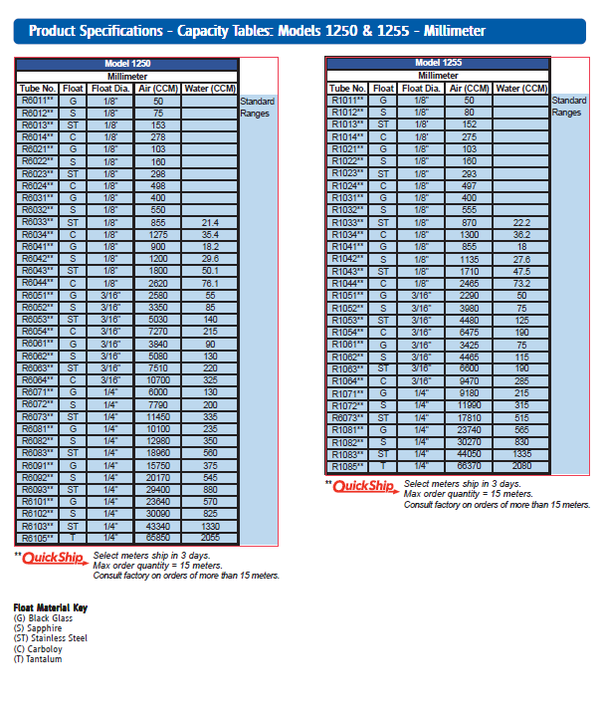
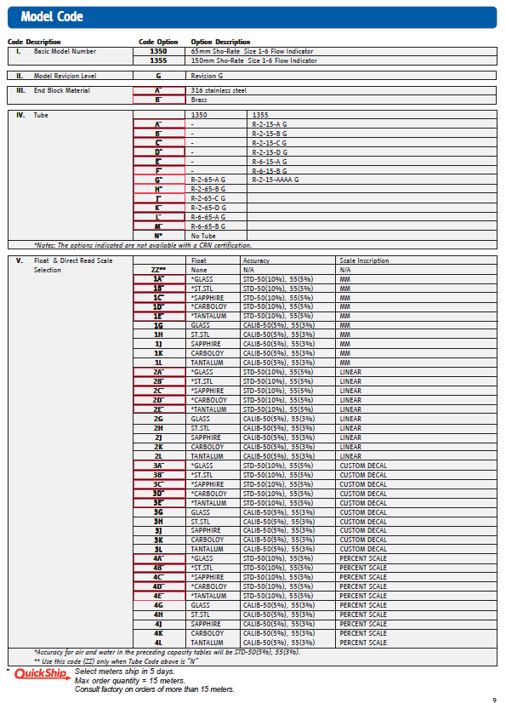
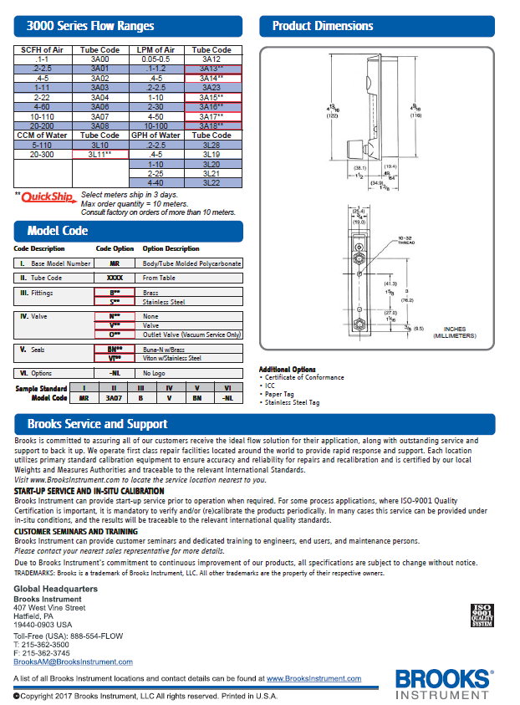
Products Available for Quick Ship
Notes:
SLA: On website, add note saying “See data sheet for most popular options.” For standard options, there is no lead time adder.
When it comes to fittings, the earlier you engage in the process, the more you can steer customers toward common options. Example: mm inch compression fitting can fit any tube (vs. ?)

Slide 18
Products Available for Quick Ship
Highlighted on MyTeamBrooks.com

Slide 19
Next Steps
Download data sheets (mobile device, print)
Familiarize yourself with the options
Think Quick Ship first when quoting customers
Help us build momentum to demonstrate a difference & success!
Tell us which products to add to Quick Ship

Slide 20
POLL: Which products would you like to see added to Quick Ship?
(Please take a moment now to respond.)

Slide 21
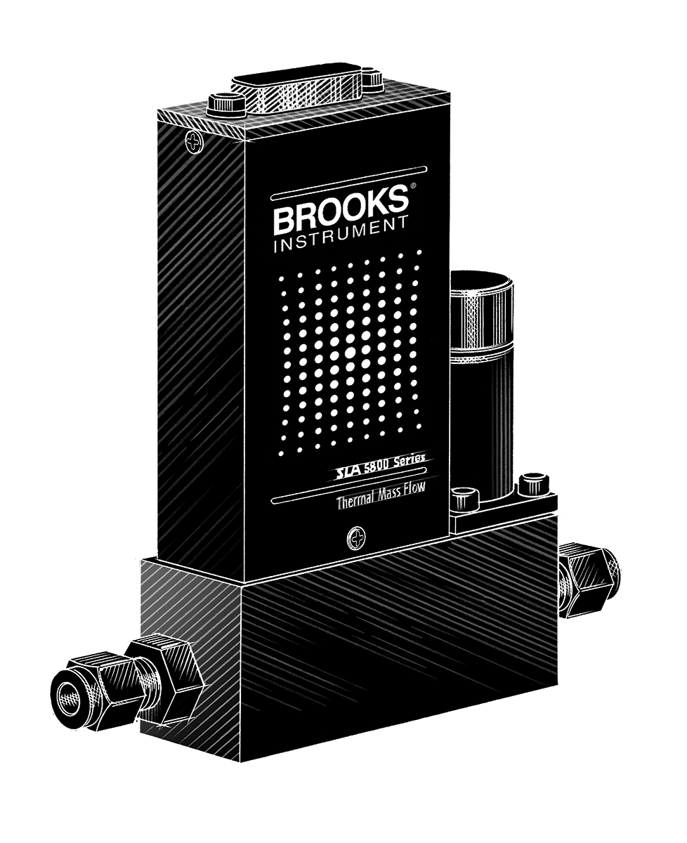
Selling SLA Pressure Controllers
Shelly McWilliams
Notes:
MFCs – on divider template.

Slide 22
Why Pressure Controllers?
In most applications where you are utilizing Thermal Mass flow controllers, there is pressure control in the process.
In many cases for industrial applications – this is still mechanical pressure control.
For every 10-15 TMF Controllers, there should be the opportunity to sell one Pressure Controller. Currently we see about 1 PC for every 100 MFCs.
Why? (send in your thoughts now via the webinar chat function)
Notes:
Where there is pressure there is flow! In many cases you will come across, this is currently mechanical pressure control. We’d like you to think about why there is a delta between ratio of PC to MFCs.

Slide 23
Call to Action
Inquire with customers where they use pressure control
For the next three months, when you talk with customers about MFCs, ask where they control pressure in their process.
Talk about some of the benefits (setpoint, droop elimination, etc.)
Feedback – expect to hear from me in 3 months asking for feedback!
Notes:
What we would like you to do is make an extra effort to discuss Pressure controllers with customers over the next three months. I’m not asking you to force a presentation down their throat, but ask where they control pressure in their process, why, what issues,etc. Next we’ll take you through a few things about pressure control as a reminder.

Slide 24
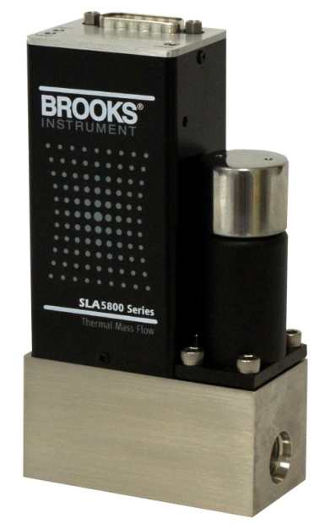
Pressure Controllers
Major Components of a PC
Sensor = Pressure Transducer
Body
Valve/Orifice
Circuit Board
Circuit
Board
Valve
Sensor
PT
Body
Orifice
Flow
Body
24
Notes:
A mass flow controller and PC are virtually the same – the main differences is that in the upstream and downstream PCs, the flow sensor is replaced by a pressure transducer. That pressure value is used to control the valve instead of a flow reading. The other special thing about PCs is that the downstream controller is flipped with the flow direction being reversed – see the next chart.

Slide 25
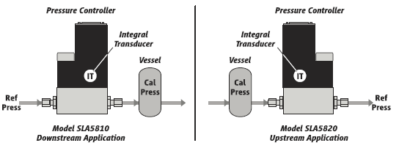
Upstream Vs Downstream
Downstream Controller
(aka Pressure Regulator)
Controls pressure downstream of itself
Increases flow to increase pressure
Upstream Controller
(aka back pressure regulator)
Controls pressure upstream of itself
Reduces flow to increase pressure
25

Slide 26
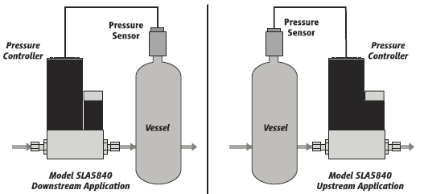
Remote Transducer Model
26
Company Confidential
Notes:
The SLA5840 is a RT option which is set up the same way upstream and downstream (although this must be madd known at the time of order). There is no Pressure Transducer integral in the device – it uses a flow sensor. That sensor can provide the customer with a flow reading output which a lot of customers find useful.
Most customers purchase this option when the Brooks Pressure Transducer offerings do not meet their needs.

Slide 27
Pressure Controller Product Offerings
Model | SLA5810/20 | SLA5840 | SLAMF10/20
Description | Standard Housing Integrated PC | Standard Housing Remote Transducer | IP66 NEMA4x (pending) Housing Integrated PC
Material | Elastomer Seals | Elastomer Seals | Elastomer Seals
Pressure Control Mode | Upstream (5810) Downstream (5820) | Remote (upstream & downstream) | Upstream (MF10) Downstream (MF20)
Pressure Ranges | 10-4500 psia | Transducer dependent | 10-4500 psia
Turndown | 20:1 | 20:1 | 20:1
Full Scale Flow Range (N2) | .003-50 lpm | .003-50 lpm | .003-50 lpm
Gases Supported | All supported by SLA | All supported by SLA | All supported by SLA
Communication Protocol | RS485, Analog, DeviceNet, Profibus | RS485, Analog, DeviceNet, Profibus | RS485, analog, Profibus
27
Notes:
Head to Head comparison of the different offerings in SLA Pressure control. We have guage and absolute pressure tranduscers available.

Slide 28
SLA Series Pressure Controllers
Available in MF housing!
High performance pressure controller series with fast response and settling time for improved pressure control
Cost savings to replacing mechanical pressure control
PID is in the device, versus custom programming
One device to install, in one package versus separate pressure measurement and valve control
Greatly reduces Hysteresis, Droop and Boost
Different meanings to different customers: less product waste, cycle time reduction, safety on over-pressuring
Notes:
First point on here is to remind everyone that these are available in an MF housing for hosedown/washdown applications.
There is a cost savings to mechanical pressure in that the PID is in the devices, and a single unit with both measurement and control. Much of the cost advantage comes in the reduction of Hysteresis, Droop and Boost.

Slide 29
SLA Series Pressure Controllers: Advantages
Electronic control of pressure setpoint
Pressure regulators require manual tuning
Electronic Pressure Controllers adjust automatically to match desired setpoint
Remote transducer option provides additional application flexibility
Notes:
Electronic pressure controllers operate to a Setpoint, versus being tuned, adding realtime flexibility (with, from the previous slide, fast response and settling time).
RT allows the customer to use whatever pressure transducer they want, and get a flow signal as well. For processes that require information on the volume of gasses in or out of a process, this can be very useful!

Slide 30
What do Electronic PCs Replace?
Pressure Signal Output
Pressure Transducer
Command Input
Compression Amplifier
Valve
Drive
Control
Drive
Adjust
Valve OR Logic
Valve
Override
Notes:
In a normal pressure control setup you have the pressure transducer, valve drive, reference pressure and the associated logic to get the desired outcome… in the SLAPC you have it all in one package!

Slide 31
SLA 5800 Series Certificates/Approvals
Mark | Agency | Certification | Applicable Standard | Details
 | UL (Recogonized) | Class I, Div 2, Group A, B, C, D Class I, Zone 2, IIC T4 Class II, Zone 22 | UL & CSA Standards | E73889 Vol 3, Sec 4
 | ATEX | II 3 G Ex nA IIC T4 Gc | EN60079-0:2012 EN 60079-15:2010 | KEMA 04ATEX 1118X
 | IECEx | II 3 G Ex nA IIC T4 Gc | IEC 60079-0:2011 IEC 60079-15:2010 | IECEx DEK 14.0072X
 | KOSHA | Ex nA IIC T4 |  | 15-AV4BO-0641 15-AV4BO-0640
 | CE | EMC Directive 2004/108/EC Directive 2011/65/EU | EN:61326-1:2006 | EMC RoHS
NOTE: Please see user manual for installation precautions to meet full area classification
Notes:
These are the SLA 5800 series approvals and the next slide

Slide 32
SLA MF Series Certificates/Approvals
Mark | Agency | Certification | Applicable Standard | Details
 | UL (Recogonized) | Class I, Div 2, Group A, B, C, D Class I, Zone 2, IIC T4 Class II, Zone 22 IP40 | UL & CSA Standards | E73889 Vol 3, Sec 4
 | UL (Listed) | Class I, Div 2, Group A, B, C, D Class I, Zone 2, IIC T4 Class II, Zone 22 IP66 | UL & CSA Standards | E73889 Vol 1, Sec 25
 | ATEX | II 3 G Ex nA IIC T4 Gc II 3 D Ex tD IIIC T 85ºC Dc | EN 60079-0 : 2012 + A11 : 2013 EN 60079-15 : 2010 EN 60079-31 : 2014 | KEMA 04ATEX1290 X
 | IECEx | Ex nA IIC T4 Gc Ex tD IIIC T 85ºC Dc | IEC 60079-0 : 2011 + Corr. 2012 + Cor. 2013 IEC 60079-15 : 2010 IEC 60079-31 : 2013 | IEC KEM 07.0043X
 | KOSHA | Ex nA IIC T4 |  | 15-AV4BO-0638 15-AV4BO-0639
 | CE | EMC Directive 2004/108/EC Directive 2011/65/EU | EN:61326-1:2006 | EMC RoHS
NOTE: Please see user manual for installation precautions to meet full area classification
Notes:
Is the SLAMF series approvals

Slide 33
SLA Series Pressure Controller
Same outline dimensions of an MFC
Pressure Controllers:
Accuracy : +/- .25% of sensor FS >300 psia
Accuracy : +/- .12% of sensor FS <300 psia
Flow accuracy of Remote Transducer PC is 0.9% rate
Absolute Pressure Sensors for pressure controllers (20 to 1 turndown)
Sensor FS Pressure Controller FS Range
4500 psia/310.3 Bara 3000-4500 psia full scale
3000 psia/206.9 Bara 300-3000 psia full scale
300 psia/20.7 Bara 100-300 psia full scale
100 psia/6.9 Bara 15-100 psia full scale
15 psia /1.03 Bara <15 psia
300 psig/20.7 Barg 100-300 psig full scale
100 psig/6.9 Barg 15-100 psig full scale
15 psig /1.03 Barg <15 psig
What is needed to control pressure? FLOW!!
Can handle flow rates as low as 3 ml/min and as high as 50 L/min
Notes:
This is a summary of the accuracy, transducer ranges and specs for the PCs. Next I will discuss a few applications.

Slide 34
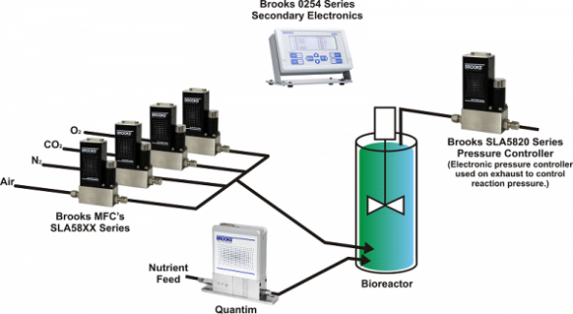
Application: Bioreactor
Nutrient Feed
Notes:
Brooks traditionally sells MFCs to control the gasses into the Bioreactor. However, with the onslaught of disposable systems, pressure becomes an important factor to manage to prevent a rupture.

Slide 35
Application: Filling (Pharma)
Stainless steel tank with no elastomer seals
Inconsistent pressure in tank, created variation in piston pump draw, made for uneven fills
Over or under fills cost $$$$$
Medicine Vessel
Piston Pump Controlled Needle Filler
Notes:
This was a neat application that we utilized the downstream PC in – when liquid medicines (biotech or traditional pharma) are created, they need to be moved from the vessel in which they were created to the filling equipment. Pressure is used to move the medicine from the stainless steel vessel to the filling equipment. Any boost or droop from the pressure can throw off the amount of medicine in the vials causing waste.

Slide 36
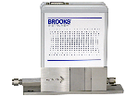
Application: Vacuum Processes
Magnetron
Target Material
Inert Gas
SLA5800 MFC
plasma
Part to be Coated
SLA5820 to
Vacuum Pump
SLA5800 MFC
Bias Voltage
Pressurized Liquid
Source
Vaporizar
Quantim
Notes:
In the sputtering process, you can control the vaccum in the chamber to optimize the process. Tight control of the vaccum leads to optimium results

Slide 37
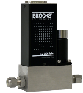
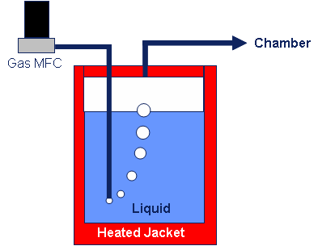
Application: Bubbler
Pressure
Controller
Notes:
Bubblers use Pressure control on the vessles to control the gas to the chamber.

Slide 38
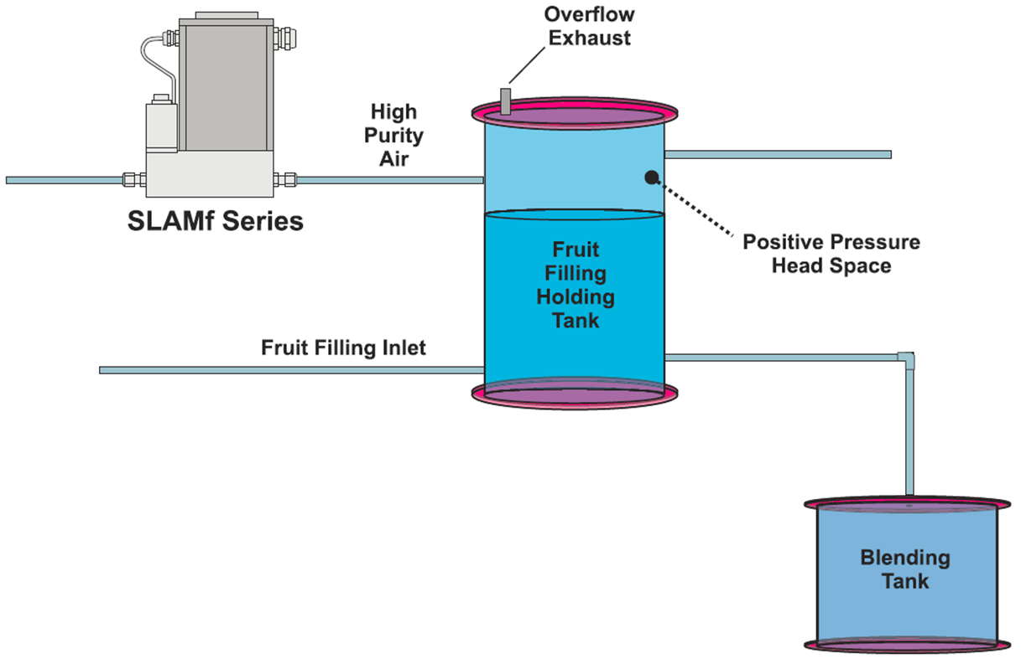
Application: Food Processing
Notes:
In this scenario for food processing, high purity air is used to create positive pressure above the viscos liquid to aid in movement to the blending tank.

Slide 39
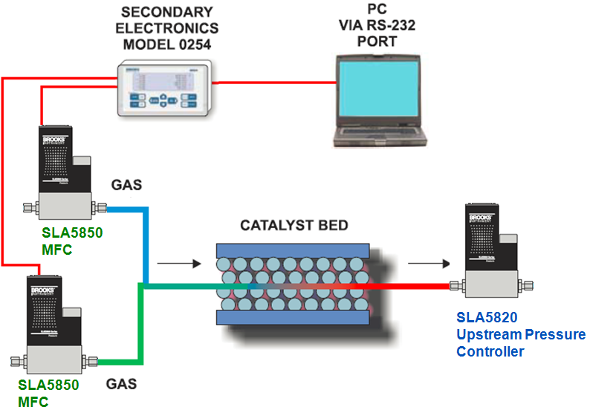
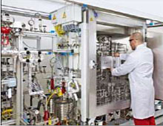
SLA Series Pressure Controller Application
Notes:
Products they purchase/consider: Brooks SLA5850, SLA5820, Quantim, 0254, Brooks Expert Support Tool
Customer Application Information:
Fluids are carefully injected into the heated reactor containing the catalyst
An Upstream Pressure Controller is used to control the pressure in the reactor and maintain a stable process.
A Gas Chromatograph is used to analyze product reaction

Slide 40
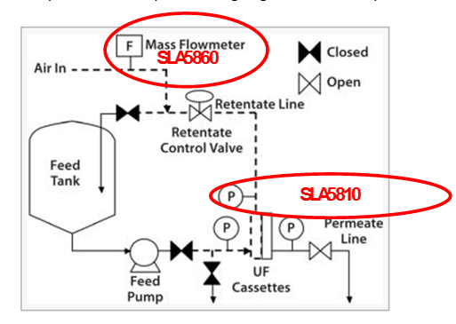
Application: Filtration skids – filter integrity check

Slide 41
Where to Learn More
SLA 5810,20,40 and SLAMF10,20 Data Sheet and Manual
Release packages on MTB.
Blog post by Howard Kramer on the basics of Electronic Pressure Control Link

Slide 42
Why Pressure Controllers?
In most applications where you are utilizing Thermal Mass flow controllers, there is pressure control in the process.
In many cases for industrial applications – this is still mechanical pressure control.
For every 10-15 TMF Controllers, there should be the opportunity to sell one Pressure Controller. Currently we see about 1 PC for every 100 MFCs.
Why? (send in your thoughts now via the webinar chat function)

Slide 43
Call to Action
Inquire with customers where they use pressure control
For the next three months, when you talk with customers about MFCs, ask where they control pressure in their process.
Talk about some of the benefits (setpoint, droop elimination, etc.)
Feedback – expect to hear from me in 3 months asking for feedback!

Slide 44
Questions?

